Slide 1
Image Filtering
Weighted Median Filter
The weighted median filter is a variation of the standard median filter that utilizes a kernel that contains weights in order to de-noise an image. These weights, if chosen properly, can incorporate time information in their structure. For example, it is a good idea to weigh the central pixels in the filter window more heavily that the others.
For this exercise you are tasked to perform weighted median filtering on an image that has been corrupted by noise.

Slide 2
Image Filtering
Weighted Median Filter
The algorithm takes as input the size of the weighted median filter and creates its kernel. It initializes its first element as 1 and as it moves on the first line, it sets the value of the current element at 1 greater than the previous one until it reaches the middle of that line. From then on, it sets the value of each element at 1 less than the previous one. It does the same for the remaining rows, but the first element of each next row is greater than the first element of the previous one by 1 until it reaches the middle row, where the values start declining by 1.
Once the kernel has been created, the algorithm finds the median pixel value of each window, but only after each one has been duplicated as many times as its weight.

Slide 3
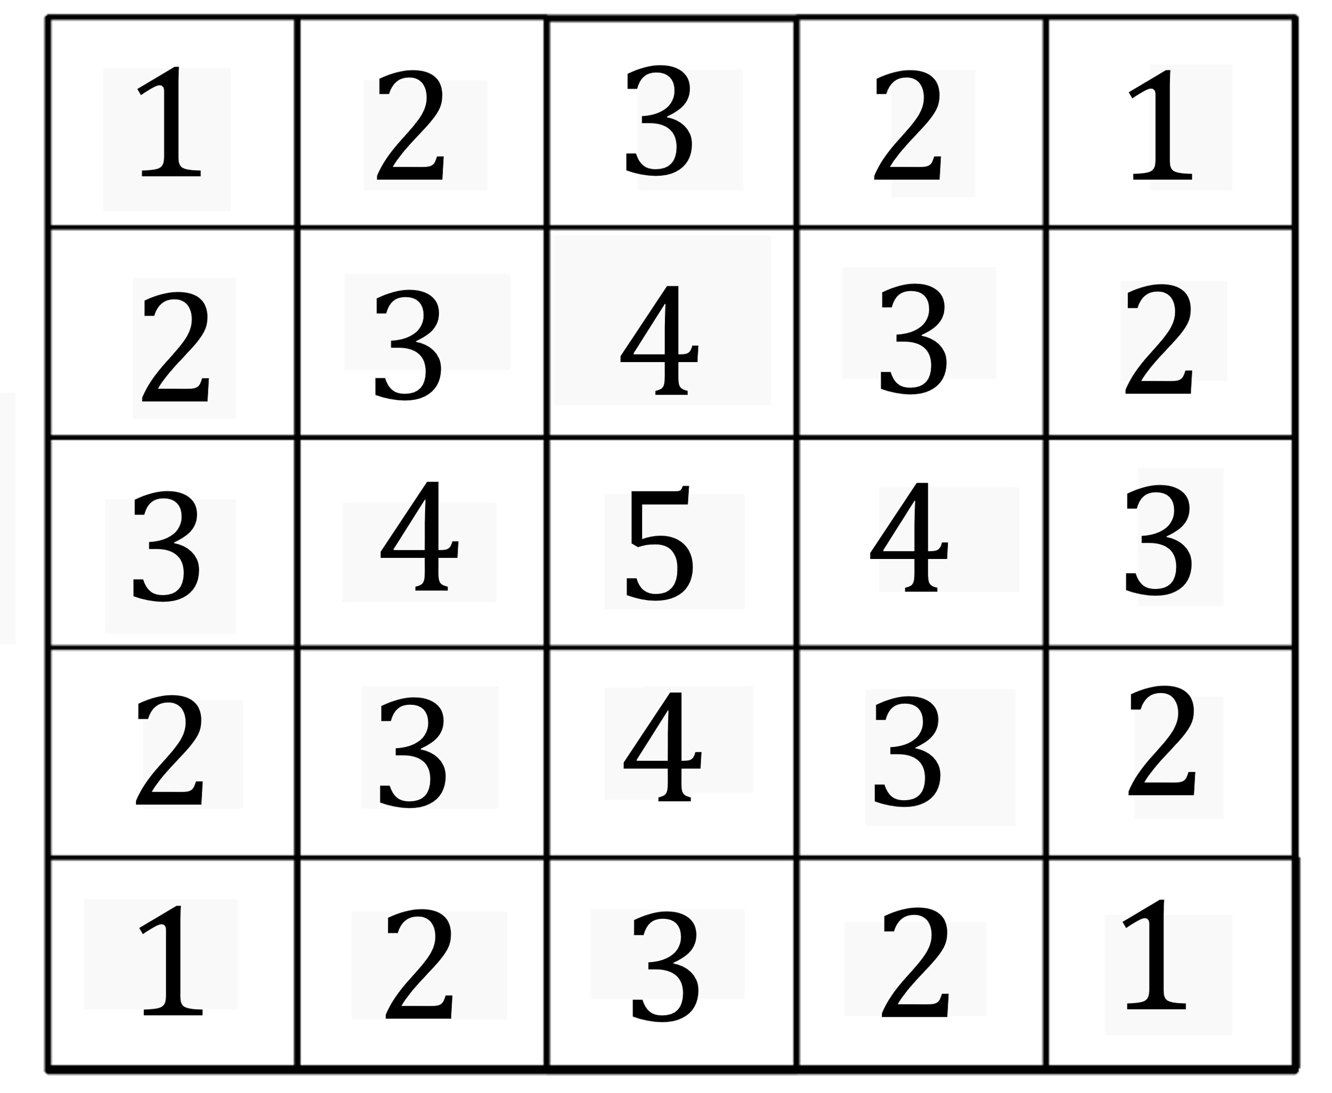

Image Filtering
Weighted Median Filter
Example of a $5×5$ weighted median filter kernel (inspired by [Khan 2017].

Slide 4


Image Filtering
Weighted Median Filter
Input example.
Intermediate output example of a $5×5$ weighted median filter on an image corrupted by salt and pepper noise.

Slide 5


Image Filtering
Weighted Median Filter
Output example of a $5×5$weighted median filter on an image corrupted by multiplicative noise.

Slide 6
References
[Khan 2017] Khan, S., Lee, DH, “An adaptive dynamically weighted median filter for impulse noise removal”, 2017.

